Slide 1

Java Programming
Arrays

Slide 2
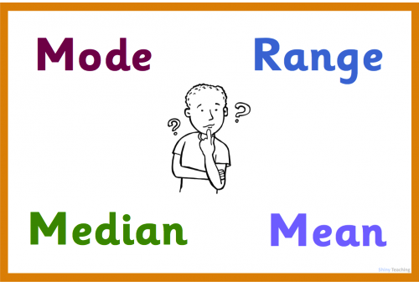
Mean, Median, Mode, and Range

Slide 3
Mean, Median, Mode, and Range
The "range" is just the difference between the largest and smallest values.
The "mean" is the "average" you're used to, where you add up all the numbers and then divide by the number of numbers.
The "median" is the "middle" value in the list of numbers. To find the median, your numbers have to be listed in numerical order, so you may have to rewrite your list first.
The "mode" is the value that occurs most often. If no number is repeated, then there is no mode for the list.

Slide 4
Find the median
The Median is the "middle" of a sorted list of numbers.
How to find the median?
Case 1: If there are odd amount of numbers. The median is the middle of the sorted numbers.
Case 2: If there are even amount of numbers. The median is the mean of middle pair of the sorted numbers.

Slide 5
Find the median
Case 1:
3, 13, 7, 5, 21, 23, 39, 23, 40, 23, 14, 12, 56, 23, 29
When we put these numbers in order we have:
3, 5, 7, 12, 13, 14, 21, 23, 23, 23, 23, 29, 39, 40, 56
The median is 23
Case 2:
3, 5, 7, 12, 13, 14, 21, 23, 23, 23, 23, 29, 40, 56
The median is (21+23)/2=22

Slide 6
Find the median
How to store a list of data?
How to sort a list of data?
How to find the median?

Slide 7
Array
An array is a data structure consisting of a collection of elements (values or variables), each identified by index.
An array is stored so that the position of each element can be computed from its index tuple by a mathematical formula.
The simplest type of data structure is a linear array, also called one-dimensional array.
we can make an array of any type (e.g. int, double, String, etc.).
All elements of an array must have the same type.

Slide 8
Array
For example, an array of 10 32-bit integer variables, with indices 0 through 9, may be stored as 10 words at memory addresses 2000, 2004, 2008, ... 2036, so that the element with index i has the address 2000 + 4 × i.
The memory address of the first element of an array is called first address or foundation address.

Slide 9
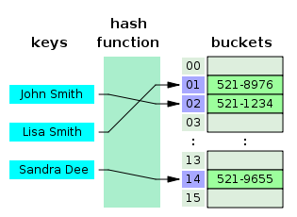
Data structure
In computer science, a data structure is a particular way of organizing data in a computer so that it can be used efficiently.
Usually, efficient data structures are key to designing efficient algorithms.

Slide 10
Create an array
An array is defined using TYPE[], TYPE can be int, double, String, etc.
To create an array of a given size, use the operator new.
int[] values = new int[5];
or you may use a variable to specify the size:
int size = 12;
int[] values = new int[size];
Note: When you create an array of ints, the elements are initialized to zero.

Slide 11
Array Initialization
Curly braces can be used to initialize an array.
It can ONLY be used when you declare the variable.
int[] values = { 12, 24, -23, 47 };
Is there an error in this code?
int[] values = {1, 2.5, 3, 3.5, 4};

Slide 12

Accessing the elements
To access the elements of an array, use the [] operator: variable[index]
The index starts at zero and ends at length-1.
Example:
int[] values = { 12, 24, -23, 47 };
values[3] = 18; // values = {12,24,-23,18}
int x = values[1] + 3; // x=27
values[4] = 1;

Slide 13
Length of an array
Each array has a length variable built-in that contains the length of the array.
int[] values = new int[12];
int size = values.length; // 12
int[] values2 = {1,2,3,4,5}
int size2 = values2.length; // 5

Slide 14
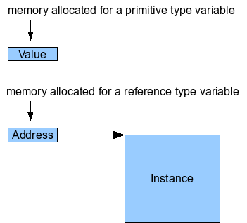
Reference to array
There are two kinds of types in Java:
Primitive type
reference type
Primitive types are basic java types
int, long, double, boolean, char, short, byte, float
The actual values are stored in the variable
Reference types are arrays and objects
String, int[],…
The value of a reference type variable is an memory address to the variable.

Slide 15
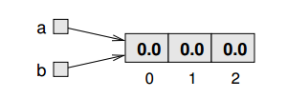
Reference to array
We can assign a different variable to refer to the same array, and we can change the value of counts to refer to a different array.
double[] a = new double[3]; double[] b = a;

Slide 16
Copying arrays
If you actually want to copy the array, not just a reference, you have to create a new array and copy the elements from the old to the new, like this:
double[] b = new double[3]; for (int i = 0; i < 3; i++) { b[i] = a[i]; }
Another option is to use java.util.Arrays, which provide copyOf that copies an array. You can invoke it like this:
double[] b = Arrays.copyOf(a, 3);

Slide 17
Printing an array
//print the elements of an array
public static void printArray(float[] array) {
System.out.print("{");
for (int i = 0; i < array.length; i++) {
System.out.print(array[i]);
if (i < array.length - 1) {
System.out.print(", ");
}
}
System.out.println("}");
}

Slide 18
Finding the smallest element
//find the smallest element of an array
public static void findSmallest(float[] array) {
int j=0;//index of the smallest element
for (int i = 0; i < array.length; i++) {
if (array[j] > array[i]) {
j=i;
}
}
System.out.println(“array[“+j+”]=”+array[j]);
}

Slide 19
How to sort the data?
Simple sort
This algorithm makes multiple passes through an array. it swaps first element of unsorted part with smaller element repeatedly and then it is included to the sorted part.
Selection sort
When algorithm sorts an array, it swaps first element of unsorted part with minimal element and then it is included to the sorted part.
Bubble sort
The bubble sort makes multiple passes through an array. It compares adjacent items and exchanges those that are out of order.

Slide 20
Simple sort
public static void sort(float[] items){
int quantity = items.length;
float tmp=0.0f;
for(int i=0;i<quantity;i++)
for(int j=i+1;j<quantity;j++)
if(items[i]>items[j]){
tmp=items[j];
items[j]=items[i];
items[i]=tmp;
}
}
5
1
12
-5
16
5
1
12
-5
16
1
5
12
-5
16
-5
5
12
1
16
-5
1
12
5
16
-5
1
5
12
16

Slide 21
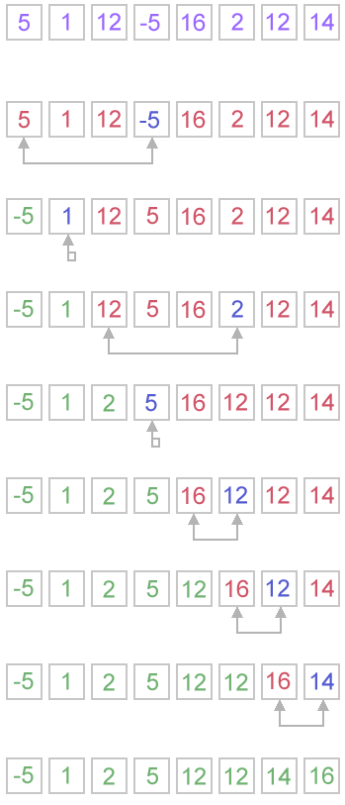
Selection sort
public static void selectionSort(int[] arr) {
int i, j, minIndex, tmp;
int n = arr.length;
for (i = 0; i < n - 1; i++) {
minIndex = i;
for (j = i + 1; j < n; j++)
if (arr[j] < arr[minIndex])
minIndex = j;
if (minIndex != i) {
tmp = arr[i];
arr[i] = arr[minIndex];
arr[minIndex] = tmp;
}
}
}

Slide 22
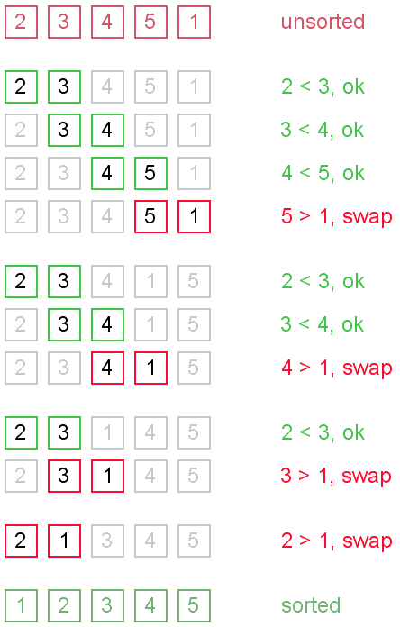
Bubble Sort
public static void bubbleSort2(int[] arr) {
int j = 0;
int tmp;
for(j=1; j < arr.length; j++){
for (int i = 0; i < arr.length - j; i++) {
if (arr[i] > arr[i + 1]) {
tmp = arr[i];
arr[i] = arr[i + 1];
arr[i + 1] = tmp;
}
}
}
}

Slide 23

Reinvent the Wheel or Not?
Before starting to solve a specific problem, try to find out if others (e.g. Java API) have already solved it.
But sometimes reinventing the wheel is necessary in order to work around software licensing incompatibilities or around technical limitations present in parts or modules provided by third parties.

Slide 24
Sorting using Java API
import java.util.Arrays;
…
Arrays.sort(arrayToSort); //ascending sort
…

Slide 25
Find the median
Case 1:
3, 13, 7, 5, 21, 23, 39, 23, 40, 23, 14, 12, 56, 23, 29
When we put these numbers in order we have:
3, 5, 7, 12, 13, 14, 21, 23, 23, 23, 23, 29, 39, 40, 56
The median is 23
Case 2:
3, 5, 7, 12, 13, 14, 21, 23, 23, 23, 23, 29, 40, 56
The median is (21+23)/2=22

Slide 26
StatisticsUtils.java
/**
* find the median of an sorted array
* @param items, it must be an sorted array
* @return the median of the array
*/
public static float median(float[] items){
int quantity = items.length;
int k=quantity%2;
if(k==0) return (items[quantity/2-1]+items[quantity/2])/2;
else return items[quantity/2];
}

Slide 27
StatisticsUtils.java
package edu.hit.arrays;
public class statisticsUtils {
public static void main(String[] args) {
float[] height1 = {1, 3, 6, 6, 6, 6, 7, 7, 11, 11, 12};
float[] height2 = {1, 2, 3, 4, 5, 6, 7, 8, 9, 10};
float[] height3 = {1};
System.out.println(printArray(height1));
System.out.println(“median is”+median(height1));
System.out.println(printArray(height2));
System.out.println(“median is”+median(height2));
System.out.println(printArray(height3));
System.out.println(“median is”+median(height3));
}
…
}

Slide 28
Find the mode
The mode of a sample is the element that occurs most often in the collection.
For example, the mode of the sample [1, 3, 6, 6, 6, 6, 7, 7, 12, 12, 17] is 6.
Given the list of data [1, 1, 2, 4, 4] the mode is not unique - the dataset may be said to be bimodal.
while a set with more than two modes may be described as multimodal.
If no number is repeated, then there is no mode for the list.

Slide 29

Find the mode
Steps:
Step1: Count each unique element
Step1.1: find the unique elements
Step1.2: Count the elements
Step2: find the element that occurs most often
Step2.1: Find the maximum number of occurrences
Step2.2: Output the mode
Case1: no mode (each element only occur one time)
Case2: output the mode (elements whose occur number equals the max count number)

Slide 30
Count each unique element
After Initialization
int items = {1, 3, 6, 6, 6, 6, 7, 7, 12, 12, 17};
int counts={1, 1, 1, 1, 1, 1, 1, 1, 1, 1, 1};
After counting
int counts={1, 1, 4, 1, 1, 1, 2, 1, 2, 1, 1};

Slide 31
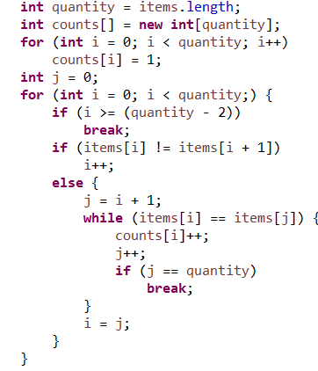
Count each unique element
Check whether the element is unique or not?
Count the unique element

Slide 32
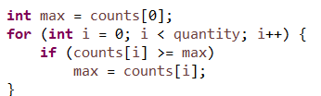
Find the maximum number of occurrences

Slide 33
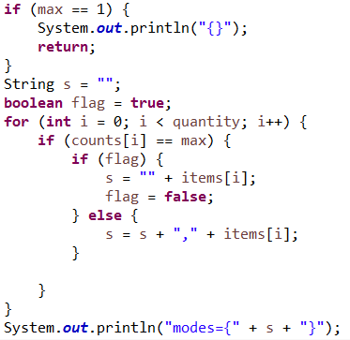
Output the mode

Slide 34
Quiz: refactor the code
Define an value method to encapsulate the code
Delete the code which displays the mode
Define an array and store the mode into the array
Return the array

Slide 35


